Slide 1
Chasing Down Performance Issues Using Distributed Tracing

Slide 2

Overview
The role of tracing in microservices
The problem with the status quo How Spring Cloud Sleuth works Setting up and using Zipkin Customizing samples and spans Summary

Slide 3



The Role of Tracing in Microservices
Locate misbehaving components
Observe end-to-end latency
Understand actual, not specified, behavior

Slide 4

Problems with the Status Quo
Instrumenting all communication paths
Collecting logs across components, threads Correlating and querying logs
Seeing the bigger picture / graph

Slide 5
Spring Cloud Sleuth
Automatic instrumentation of communication channels.

Slide 6

Glossary of Spring Cloud Sleuth Terms
Span
Trace Annotation
Client Sent
Server Received
Server Sent
Client Received
Tracer

Slide 7
Anatomy of a Trace
Trace ID = X Span ID = B Server Received
Trace ID = X Span ID = C
Trace ID = X Span ID = D Client Sent
Trace ID = X Span ID = D Server Received
Trace ID = X Span ID = E
Trace ID = X Span ID = A
Trace ID = X Span ID = B Client Sent
Request
Service 3
Response
Request
Request
Trace ID = X Span ID = D Client Received
Trace ID = X Span ID = D Server Sent
Trace ID = X Span ID = E
No Trace ID No Span ID
Service 1
Service 2
Trace ID = X Span ID = F Client Sent
Trace ID = X Span ID = F Server Received
Trace ID = X Span ID = G
Response
Response
Request
Trace ID = X Span ID = A
Trace ID = X Span ID = A
Trace ID = X Span ID = B Client Received
Service 4
Response
Trace ID = X Span ID = B Server Sent
Trace ID = X Span ID = C
Trace ID = X Span ID = F Client Received
Trace ID = X Span ID = F Server Sent
Trace ID = X Span ID = G

Slide 8
What is Automatically Instrumented?
Spring Cloud Gateway
Spring Cloud CircuitBreaker
WebFlux support
Sync and async RestTemplate, WebClient
Spring Integration, Stream, Function
@Async and @Scheduled operations

Slide 9

<dependency>
<groupId>org.springframework.cloud</groupId>
<artifactId>spring-cloud-starter-sleuth</artifactId>
</dependency>
Adding Spring Cloud Sleuth to a Project

Slide 10

Demo
Adding Spring Cloud Sleuth to services
Updating properties files to reveal traces Testing services and observing output

Slide 11
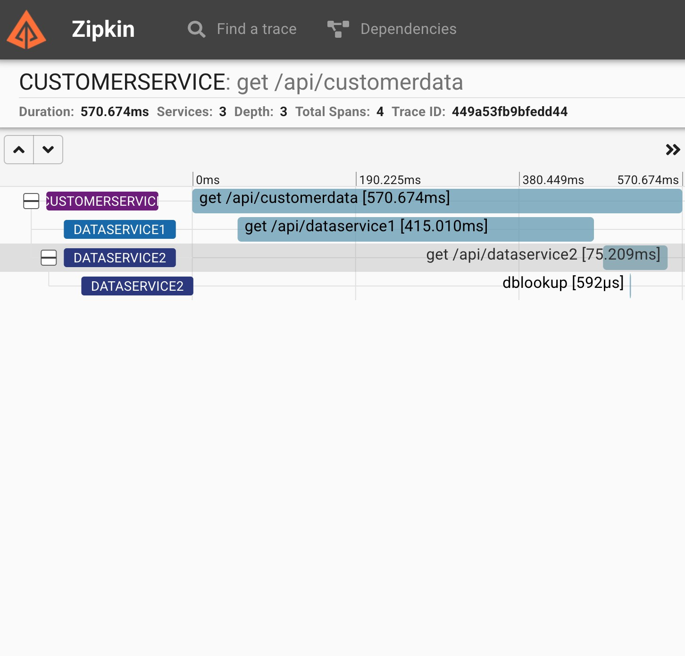
Visualizing Latency with Zipkin
Originally created by Twitter
Collects timing data
Shows service dependencies Visualize latency for spans in a trace Many integrations, besides Spring

Slide 12
<dependency>
<groupId>org.springframework.cloud</groupId>
<artifactId>spring-cloud-sleuth-zipkin</artifactId>
</dependency>
Add Sleuth with Zipkin Over HTTP

Slide 13
Demo
Download prepackaged Zipkin server
Start up the server
Update services to send spans to Zipkin

Slide 14

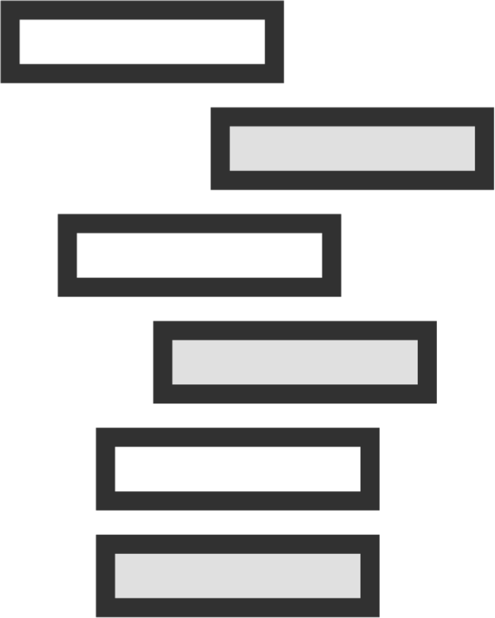
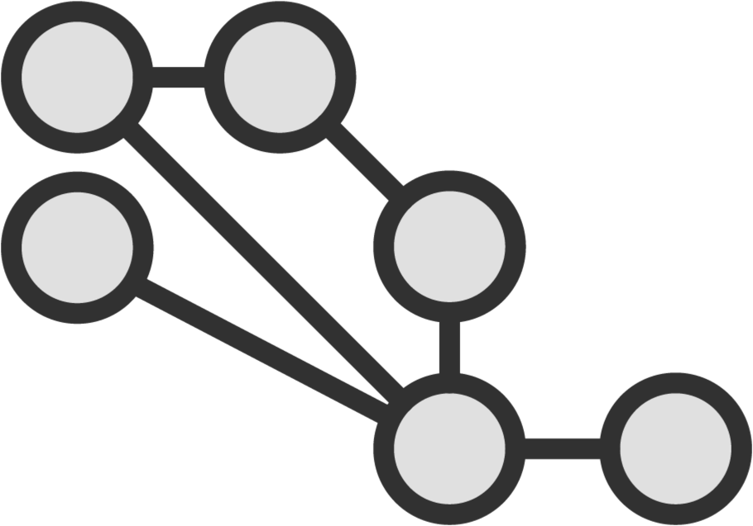

Visualizing and Querying Traces in Zipkin
View dependencies
Find a trace and view details
Perform queries
Look at durations and latency

Slide 15
Demo
Viewing the dependencies between our services
Analyzing the details of a trace Filtering by time duration

Slide 16

Sleuth exports 10 spans per second, by default
Can set property for spring.sleuth.sampler. probability = 1.0
Skip patterns and custom samplers give more control

Slide 17
Demo
Experimenting with sampler percentages
Setting a skip pattern
Viewing logs and Zipkin results

Slide 18
Manually Creating Spans
Create new spans
Continue existing ones
Associate with explicit parent
Add metadata to spans

Slide 19
Demo
Adding span to data query service
Including tags on new spans Calling the microservice Observing new span in Zipkin

Slide 20
The role of tracing in microservices
The problem with the status quo How Spring Cloud Sleuth works Setting up and using Zipkin Customizing samples and spans
Summary

